Slide 1
Advocacy
Ellen Lyons
Vice President Of Advocacy
Damaris Allen
Family Engagement Chair
Veronica McDonald
Legislative Chair

Slide 2
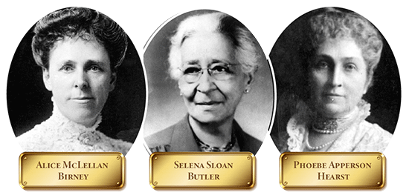
PTA Is The Oldest, Largest Child Advocacy Organization In The United States

Slide 3
IMPORTANT: PTA IS A NON-PARTISAN ORGANIZATION
We serve students, families and educators. Our guiding principles are child welfare, raising the standards of home life, and advocating for laws to further education and well being of children.
Our values are collaboration, commitment, diversity, respect and accountability. See https://floridapta.org/our-mission/
We do not attack people, we do not endorse individual candidates, but we do advocate for anything that falls within a national, state or local position statement. To find our position statements and resolutions, click here:
Current Statements: https://floridapta.org/media/2019/08/F19-20.Florida_PTA_Action_Platform_Current_Position_Statement.pdf
Resolutions direct local units: https://floridapta.org/resolutions/
National, has drop down bars: https://www.pta.org/home/advocacy/ptas-positions/Individual-Position-Statements
https://floridapta.org/our-mission/

Slide 4
Non-Partisan & 501(c)(3) status
To retain tax-exempt status and continue to receive tax-deductible contributions, those PTAs that are recognized as being tax exempt under Internal Revenue Code (IRC) Section 501(c)(3) may not (1) devote more than an insubstantial part of their activities to influence legislation (generally interpreted as not exceeding five percent of total expenditures); (2) participate in any political campaign on behalf of or in opposition to a candidate for national, state, or local public office. A unit’s failure to comply with these restrictions may endanger council, State and National PTAs IRC 501(c)(3) status. Legislative activities must not exceed the limitations placed upon the Florida PTA and its units under the federal tax laws. In order to ensure that the limitations are not exceeded, records should be kept with respect to the amount of time, money, and volunteer activity such efforts involve. PTA must never support or oppose political parties or candidates, including those running for school boards on nonpartisan slates. However, PTA may adopt a position expressing its support for or opposition to issues dealing with the health, safety, education or general well-being of children and youth, but only to the extent permissible with respect to the requirements of each PTA’s tax-exempt status. Nothing in the law or in PTA bylaws prohibits members as individuals from exercising their civic responsibilities in personal and partisan ways, including running for offices themselves.
From https://floridapta.org/policies/

Slide 5
Florida PTA Diversity and Inclusion Policy
PTAs at every level must:
Openly assess beliefs and practices to assure inclusiveness and guard against discrimination;
Make every effort to create a PTA board and membership that is inclusive and reflective of its community;
Encourage that all PTA activities at the school be planned by a committee which is representative of the population;
Foster programs and practices that eliminate bias, prejudice and misunderstanding within their communities;
Become acquainted with the leaders of the many diverse groups in the community and collaborate with them to increase parent, family and community involvement;
Educate its leaders and members to the needs, cultural beliefs, traditions and family structures of the population they serve; and
Propose change wherever discriminatory practices are perceived.
PTA values and appreciates diversity, which enriches and strengthens the structure of our society within our state and nation.
From https://floridapta.org/policies/

Slide 6
Pro Tip: It’s going to have to be you.

Slide 7
What Advocacy Means at the Local Unit
Ask for what you want as a PTA
Safety (sidewalks, crosswalks, streetlights, school safety study, understanding active shooter drills)
Health (meals for testing, sanitation, school nurse)
Funding for positions at your school (ESE, aides, permanent teachers)
Funding for school improvements and beautification
Funding for technology (district is going 1:1 computer/student with progress monitoring and upgrading wifi)
Informing parents about school, local and national issues affecting students and families
Look to PTA position statements for guidance

Slide 8
Advocacy Successes At Local Unit Level
Stop signs and crosswalks at dangerous intersections
Prevention of loss of teachers
Mediation of disputes by Region Superintendent.
Click here for list of Schools assigned to Regional Superintendents: https://www.hillsboroughschools.org/cms/lib/FL50000635/Centricity/Domain/4/Schools%20by%20Region.pdf
Examples of information on this page:

Slide 9
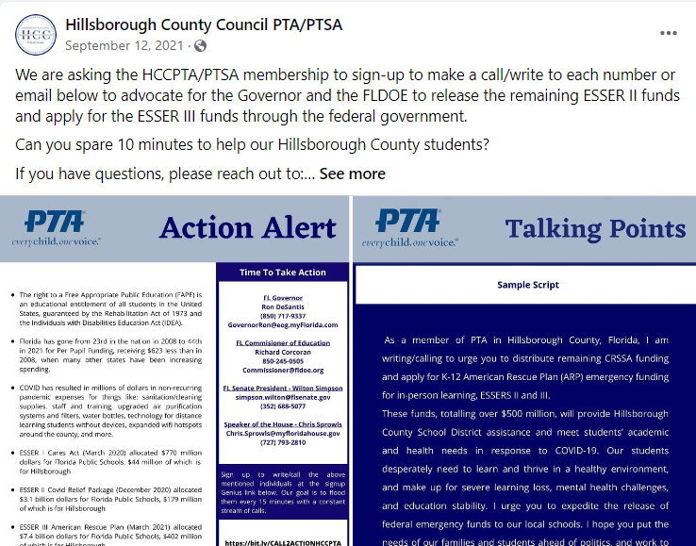
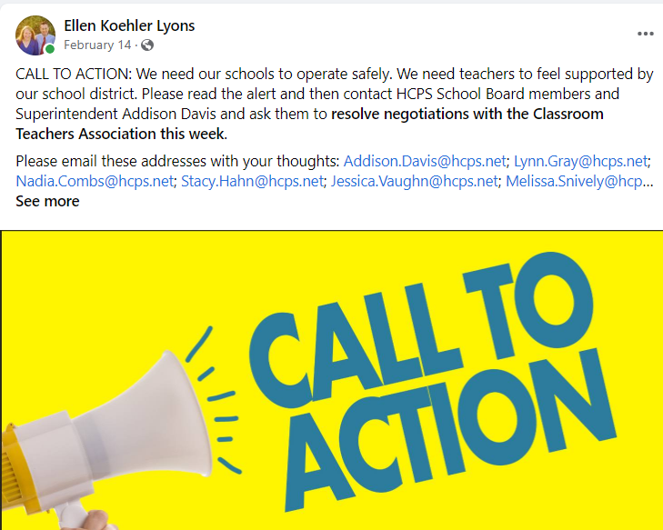
Advocacy: County, State and Federal Level Create a campaign around an issue of interest to families Ensure it comports with or does not contradict a stated PTA position statement or resolution Contact representatives, school board members

Slide 10
Topics for Advocacy
Boundary change and School repurposing: ﻿Schools identified by the consultant as potential for
partial or full repurposing: Adams Middle School Chamberlain High School Cleveland Elementary
Greco Middle School Jennings Middle School Just Elementary School Kimbell Elementary School
McLane Middle School Madison Middle School Morgan Woods Elementary School Smith Middle
School
Funding increases
Safety
Pending legislation
Adjustment to equalize 1.5 capital mills

Slide 11
Pending Legislation
HB1 School Choice, Tuck
SB52 Required Instruction in Public School, Burgess
HB19 Individual Education Plan, Tant
HJR31 Partisan School Board Elections, Roach
HB51 Prohibited Discrimination Based on Hairstyle in the Education System, Driskell
HB107 Summer Youth Service Learning, Edmonds
SJR94 Partisan School Board Elections, Gruters

Slide 12
How to build a platform
Determine what is important to your local unit
Research if a PTA resolution already exists
If one does not exist, consider looking at multiple resolutions together to see if your project falls within the parameters of multiple resolutions
Write the resolution/position
If no clear basis for advocacy campaign exists in National or Florida PTA resolutions/positions have board vote on it
Build a campaign to get what you want

Slide 13
How to Build Coalitions
Research
Understand relationships
Build Relationships
Get everyone to speak up
Handling nay-sayers

Slide 14
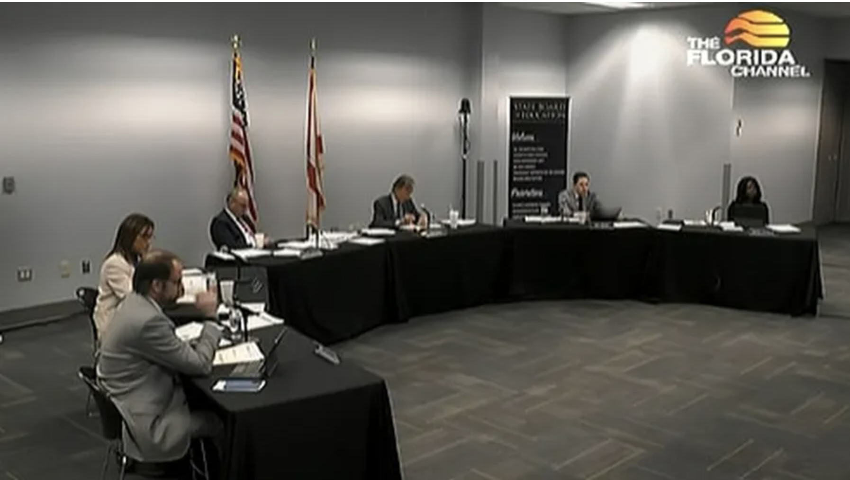
Successes at County, State and Federal Level
Campaign to release ESSER (Covid relief) dollars from FLDOE in 2021
Campaign to reduce number of college and career counselors laid off by district
Campaign to postpone application of new concordant score rule by FLDOE
Increased Impact Fee Funding from Hillsborough County, for money to build new schools
Campaign to demand district complete bargaining for salaries with HCTA in 2022

Slide 15
Top Priority: Education Funding Advocacy in Florida/Hillsborough County
Florida Education Finance Program (“FEFP”) pays Base Student Allocation (BSA) of $4,587.40 plus categorical and required local effort of $3,629.34 for a total of $8,216.74 per full time equivalent (“FTE”) student. Additionally, Florida students receive about $1,243 from the federal government.
Current problems:
Underfunding from legislature
48th in teacher pay
Hillsborough salary compression
1.5 capital mill inequality
Class size historically and current statute defining core curricula
Extensive statutorily mandated testing

Slide 16
One FTE Student = $8,216.74
(really about $9,459.74 after federal money)
Base Student Allocation, $4,587.40 – 55.8%
Required Local Effort Property Taxes but turned into categorical, $2,506.11 – 30.5%
Unrestricted Property Taxes, $493.01 6%
Other Categorical and Class Size Reduction, $630.22 - 7.7%
*** Federal Money $1,243.00***
Capital Improvement funds based on 1.5 mills

Slide 17
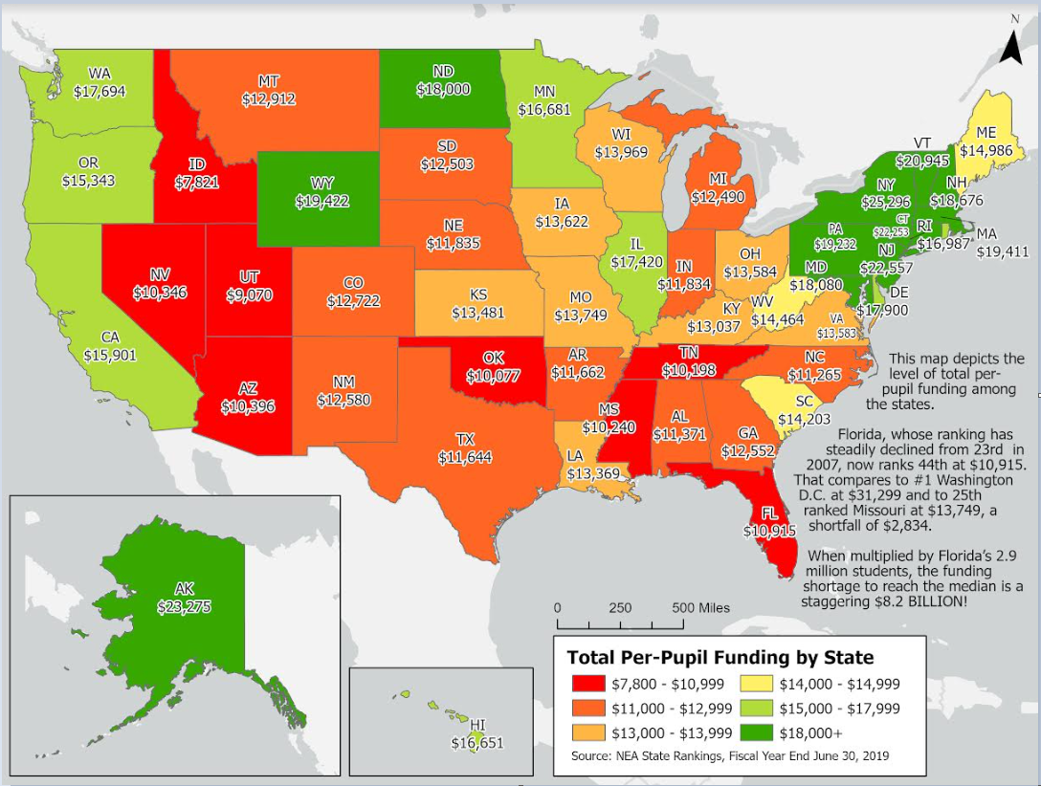
National Education Association Total Per-Pupil Funding By State for 2019, this is an average of all districts, and about $1200 of the funding for each state is federal per pupil funding either direct funding or block grants through the states.

Slide 18
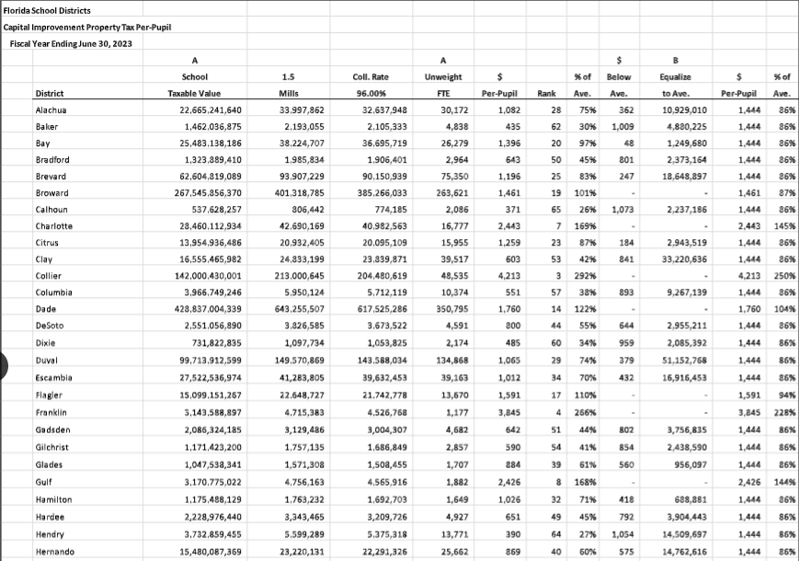
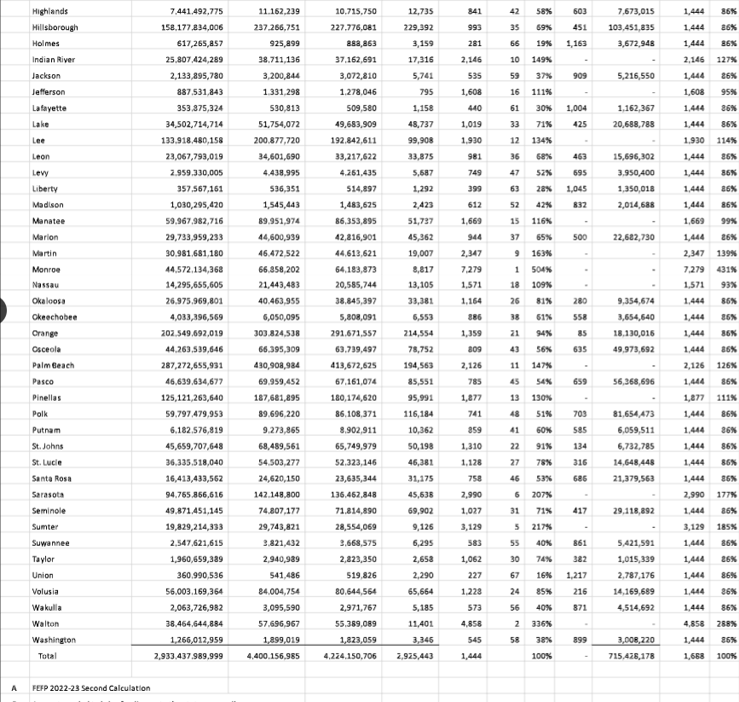
Capital Improvement Property Tax 1.5 mills, unequalized, as calculated for year ended 6/30/2023
Hillsborough gets 86% of what average districts get

Slide 19
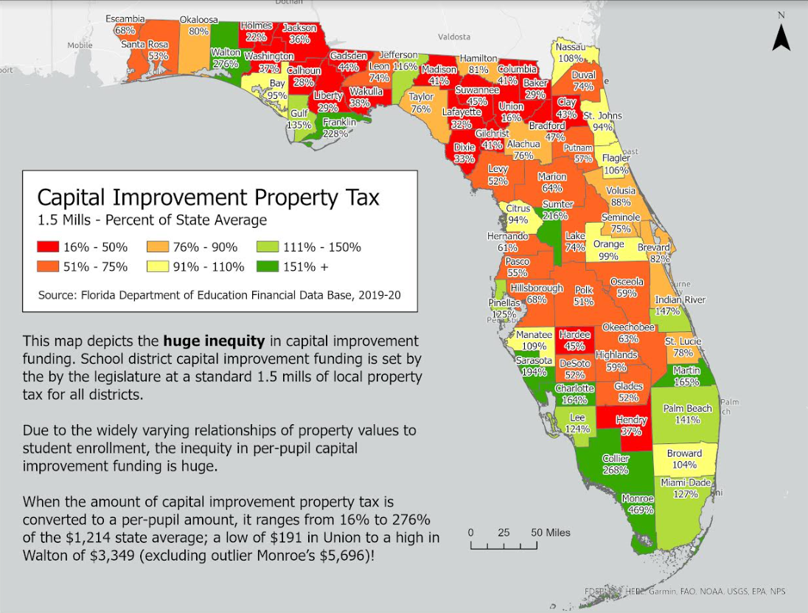

Slide 20
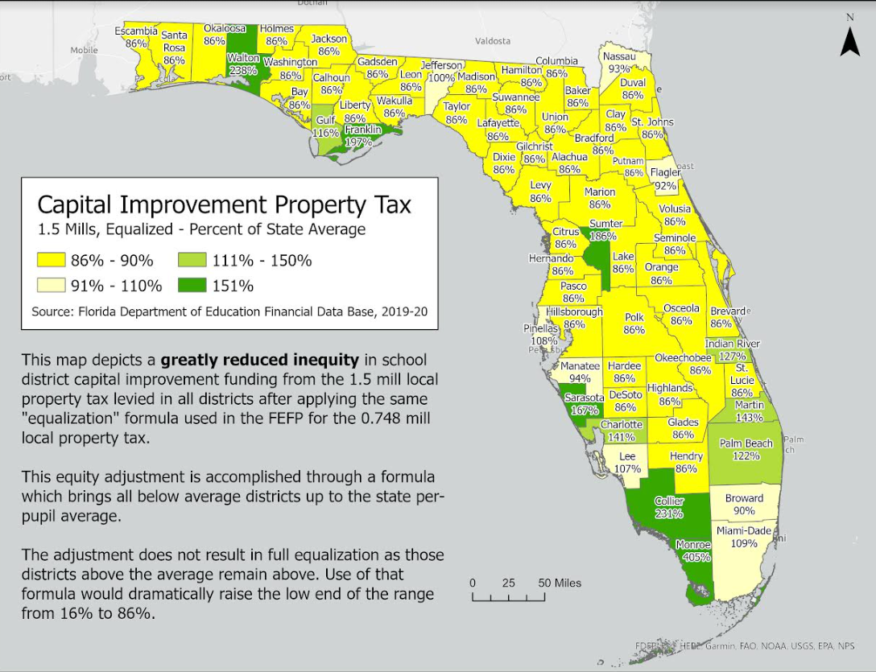

Slide 21
Federal Statistics https://educationdata.org/public-education-spending-statistics#florida
Florida receives the third-largest amount of federal K-12 education funding because the state government funds education at a lower per-capita rate. As of June, 2022, Florida was 43rd in funding education and 42nd in spending.
Florida K-12 schools spend $9,983 per pupil for a total of $28,425,418,000 annually. Expenditures are equivalent to 2.50% of taxpayer income.
Florida K-12 schools receive $3,539,362,000 or $1,243 per pupil, from the federal government. State funding totals $12,204,010,000 or $4,286 per pupil. Local funding totals $15,888,579,000 or $5,580 per pupil. State and local funding is equivalent to 2.47% of Florida’s taxpayer income.
Federal education funding is equivalent to 0.31% of the state’s taxpayer income.
Funding for K-12 education in Florida totals $31,631,952,000 or $11,109 per pupil.

Slide 22
Post Secondary Funding Facts
Federal funding for postsecondary schools is $3,206,534,000 or $1,126 per pupil.
At the postsecondary level, public colleges and universities spend $18,141 per pupil, 30.5% of which goes toward instruction. Among postsecondary schools, federal funding averages $1,547 per student.
State and local funding averages a combined $7,331 per student.
Tuition accounts for 17.1% of all funding, which is an 7.97% smaller share than the previous year.
6.04% of all postsecondary funding comes from sales and services of auxiliary enterprises.
Florida’s 2-year community colleges spend 1.56% of what its 4-year public colleges spend in a year.

Slide 23
Example of Hillsborough PTA Legislative Platform
ID problem
What is source of problem? Legislation, Admin Code, Rule?
State how to fix problem
State the cost/impact/scope/magnitude of problem and solution

Slide 24
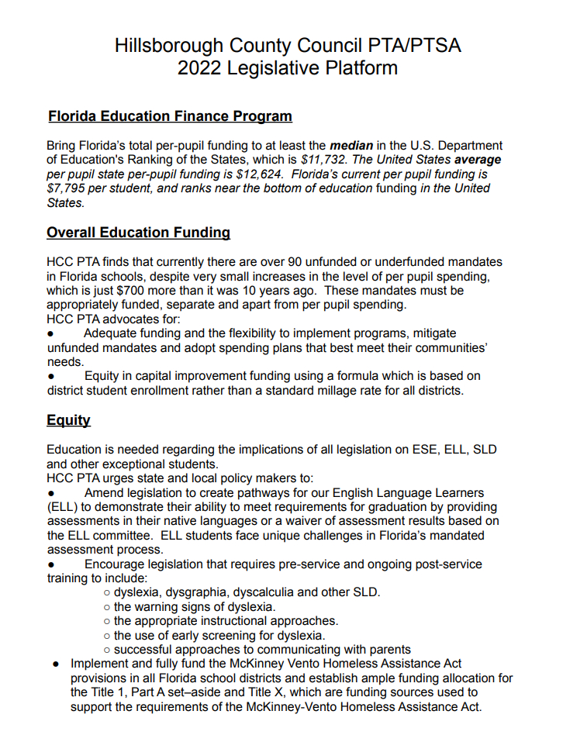

Slide 25
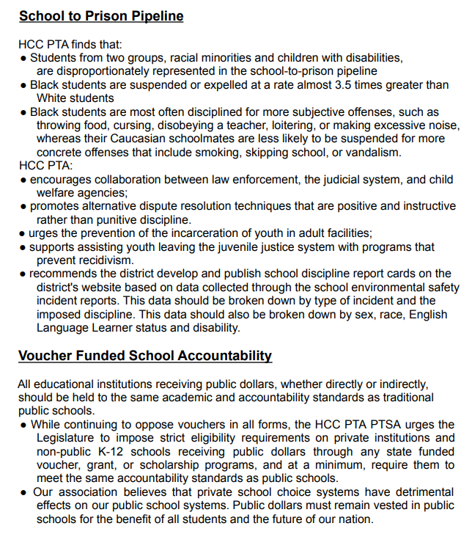

Slide 26
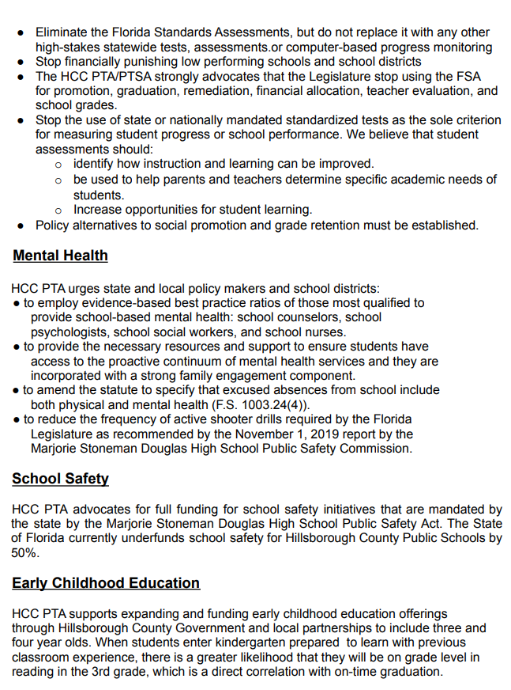

Slide 27
Brief Overview – Public Education in Florida
2007 Per pupil funding reduced to $7,114 during special session
1996 Florida legalizes charter schools
2008 Voters passed Amendment I, which decreased property tax revenues. The legislature also lowered the millage for school capital projects from 2.0 to 1.75 and then to 1.5. Projected cuts equal $9.3 billion over five years. FEFP is reduced to $6,883.90
1998 Florida creates FCAT standardized testing
1999 Under Bush, Florida legalizes Opportunity Scholarship Program vouchers and McKay Scholarship for students with disabilities
2009 Property tax values plummet; FEFP drops to $6,535.86 ($10k national average); Stimulus money helps districts balance their budgets. Gates grant begins in HCPS
2002 Class Size Amendment in Florida Constitution wins voter approval, litigation over class size begins
2003 Florida begins appointing education commissioners
2010 FEFP up to $6,883.17; FL legislature shifts more to property owners, (51% paid by State, 49% paid by local property owners)
2011 Federal Stimulus money runs out. FEFP back down to $6,333.85. This is the beginning of serious funding issues
2006-07 High-water-mark of education funding: $7,205.81/student; ranked 23rd nationally
Notes:
1996 - Florida legalizes charter schools; Base student allocation is $2,558.17, and $3,297.89/per pupil with categoricals
2006 High-water-mark of education funding: $7,400/student (national average was $9,138), ranked 23rd in the nation for per pupil funding. State provides 61% and property taxes fund 39% of per pupil funding
?

Slide 28
Hillsborough County 2012 and Beyond
2015 – School board fires superintendent; doesn’t fire coaches or other added staff. ; Private consultant Gibson submits report that serves as basis to cut and privatize services. FEFP is $7,105.60
2018 Hillsborough seeks a half-cent sales surtax referendum which provides in excess of $130 million/year to be spent on capital projects
2021 –ESSER II and III held back by FLDOE, dispute with FLDOE, PTA campaign, 1,000 position cuts in HCPS. Sup says we are at “foundational level of teaching.” FEFP is reduced to $7,679.17 (down by $178.91/student).
2012 Gates Grant tied to Common Core; teacher coach system causes hiring of district staff. FEFP is $6,458.78
2020 New Sup. Covid starts the next week. Millions of additional expenditures on devices, cleaning, and reopening plan. FEFP is $7,858.08, CARES/ESSER I ($45 mil)
2014-5 Gates Grant starts going bad; Gates Foundation fails to pay $20 million to district. FEFP is $6,925.33
2016 other districts seek millage and additional taxes; HCPS doesn’t FEFP is $7,172.15

Slide 30
• In 2007, public education funding was at its peak in Florida, thus at that time, FL was ranked 23rd nationally in public education funding
• Currently, Florida is ranked 44th in per pupil funding and 48th in teacher pay
• Out of 61 FL counties, HCPS is ranked 45th in funding
• 90+% of current budget is spent on district salaries. HCPS is the 8th largest school district in the United States
• 23 other counties (about a third of the state) sought a Millage in years past and approved a Millage to supplement public education funding given by the state of FL. Only Hillsborough’s millage referendum did not pass

Slide 31
After financial crisis, funding increases marginally

Slide 37
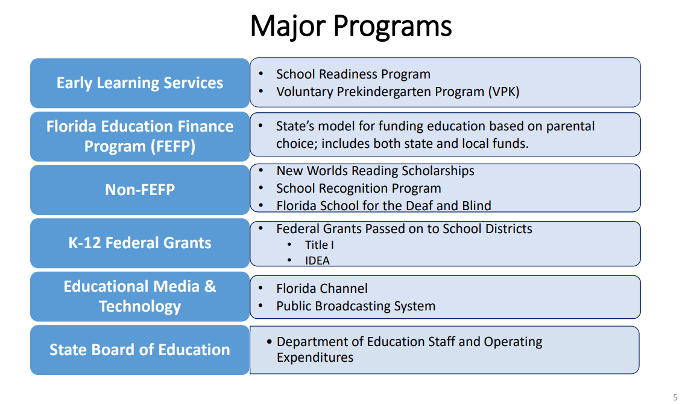

Slide 39
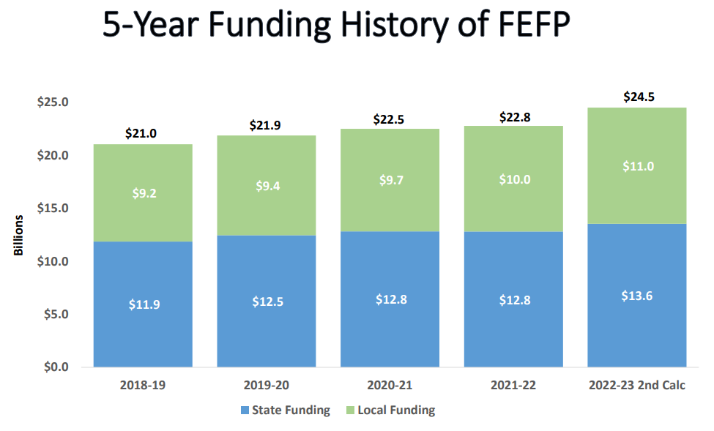

Slide 40
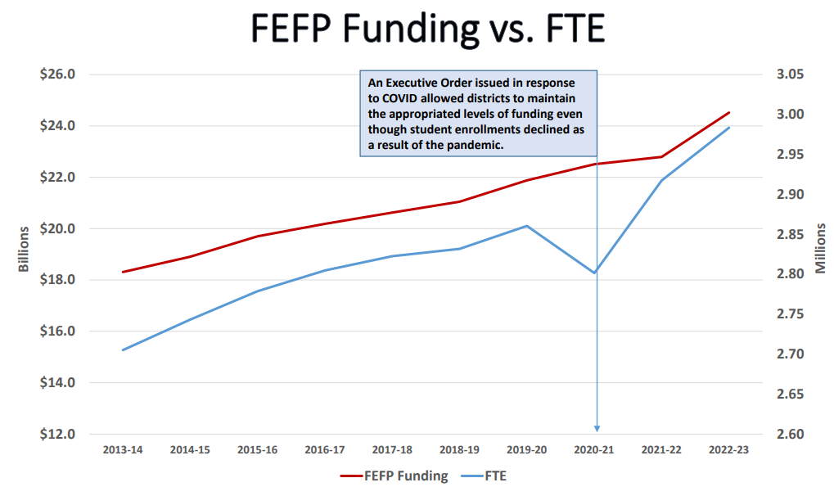

Slide 41
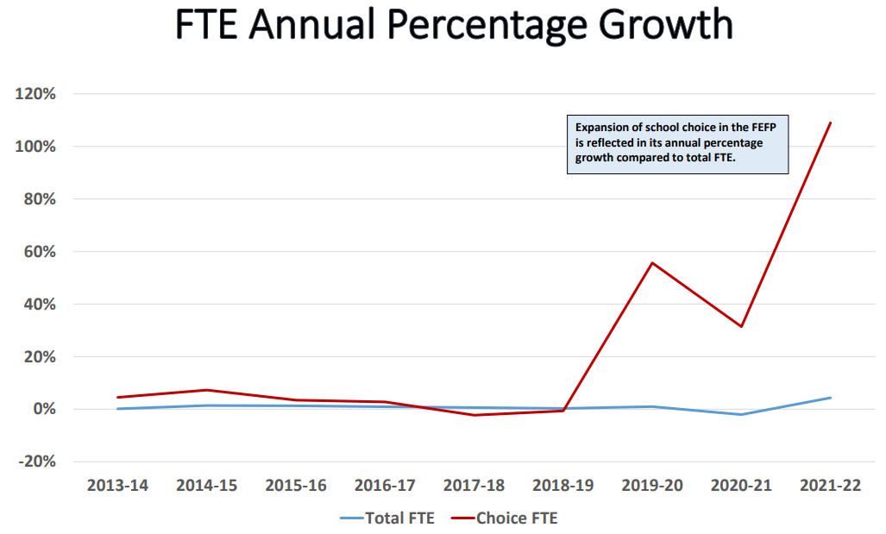

Slide 42
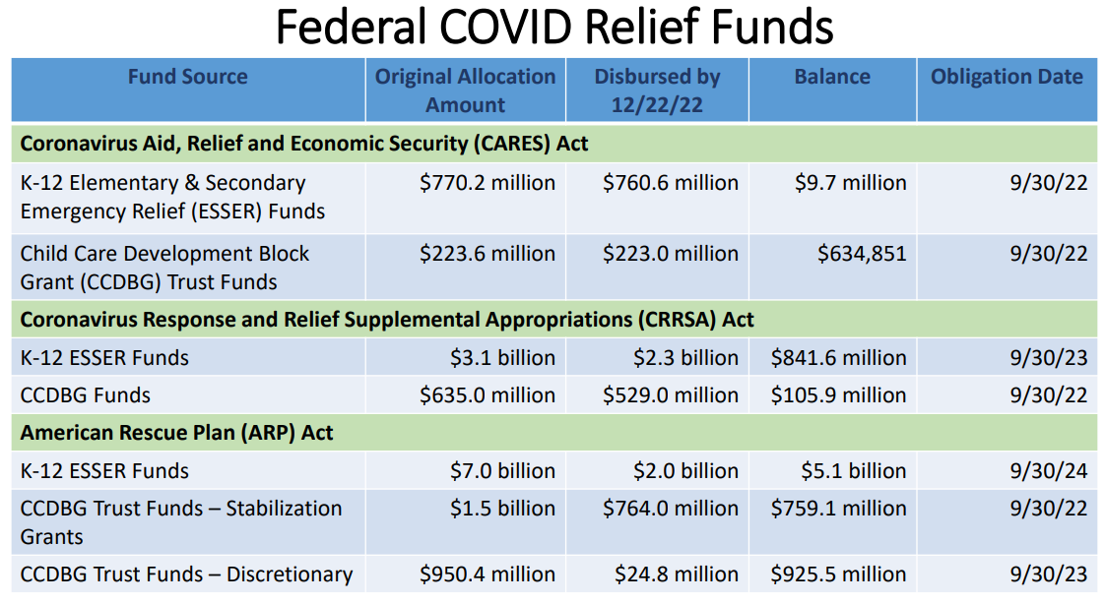

Slide 44
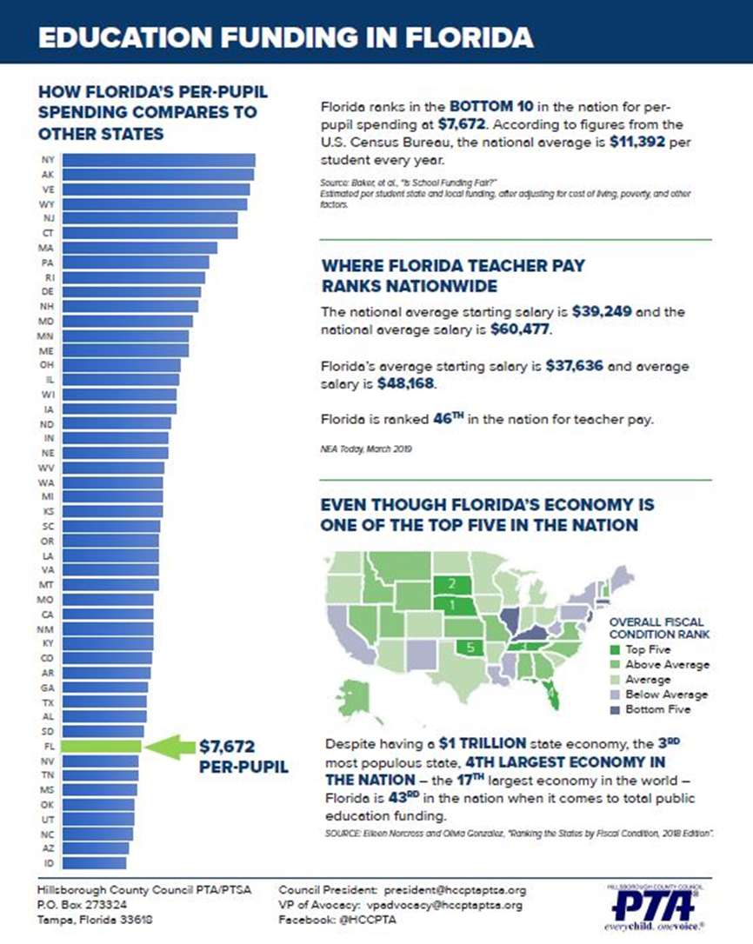

Slide 45
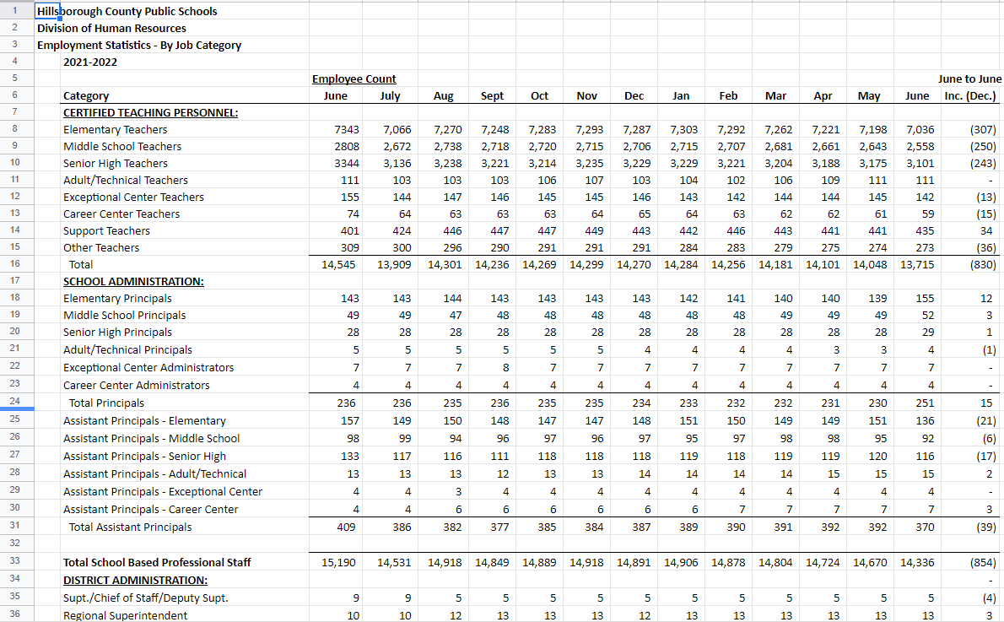
Employment Statistics, tells you how many people employed at each level

Slide 46
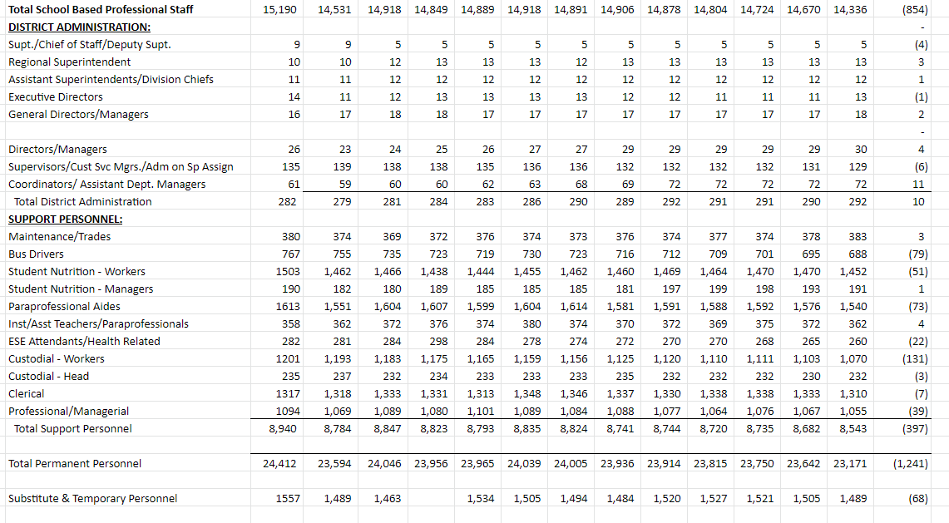

Slide 47
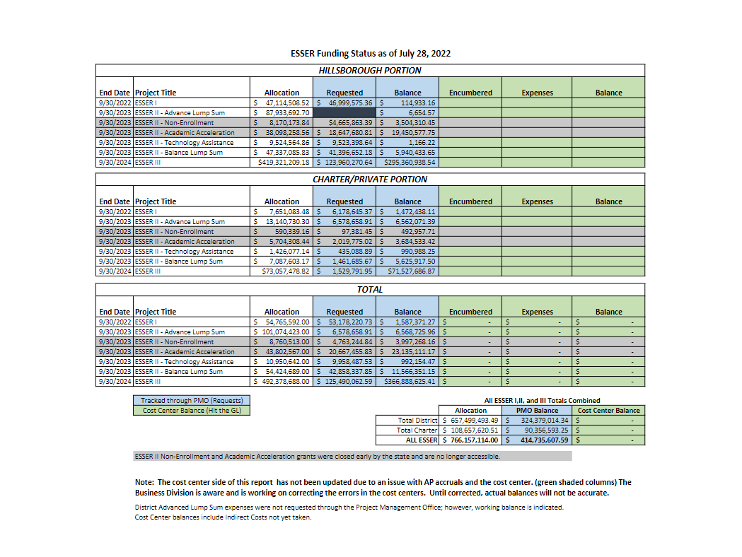

Slide 48
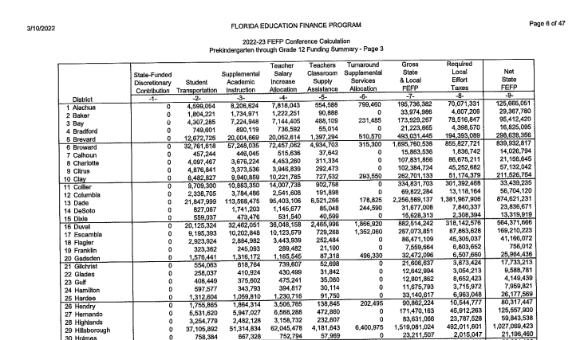
FEFP Calculation – bus riders $37 million, supplemental academic instruction based on student need$51 million, teacher salary increase allocation $62 million; teacher supply assistance $4 million, turnaround services $6.4 million, Gross state and local FEFP $1.5 billion, RLE $492 million

Slide 49
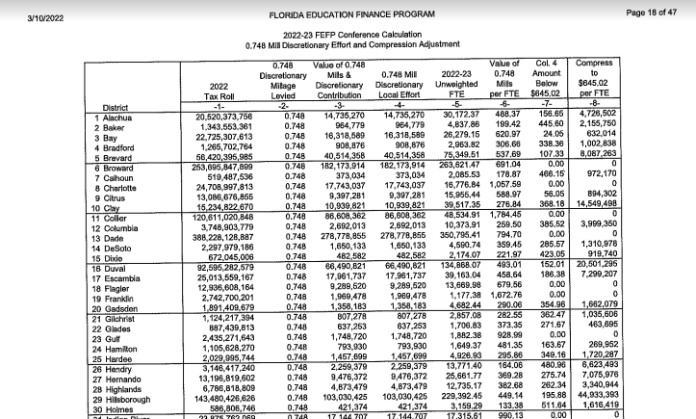
How the .0748 discretionary mill is adjusted for equity – helps raise up property poor places like Hillsborough County because we get $195 more per student

Slide 50
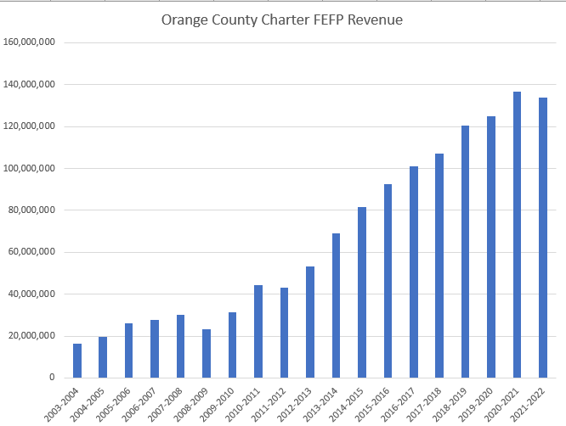
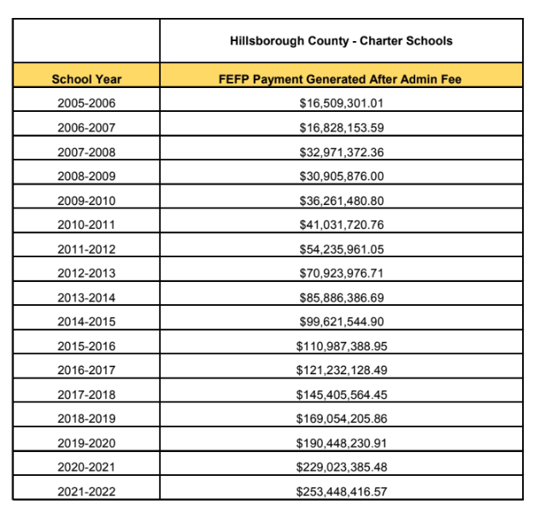
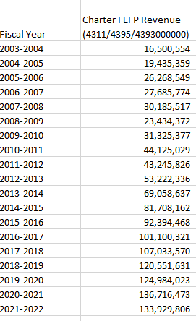
Charter impact, Hillsborough v. Orange

Slide 51
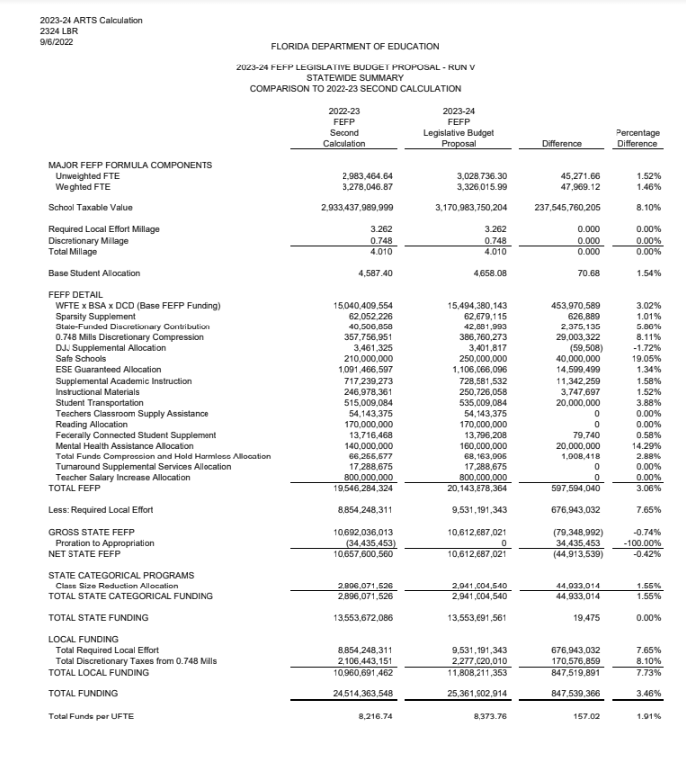
FEFP Calculation – in case there are questions

Slide 52
Join Our Facebook Page

